Slide 1
PART 2

Slide 2
CONTENTS
Defining the Project
Developing a Project Plan
Managing Risk
Reducing Project Duration
Progress and Performance Measurement and Evaluation
Project Closure
Copyright © 2006 The McGraw-Hill Companies. All rights reserved.
McGraw-Hill/Irwin 4–<number>

Slide 3
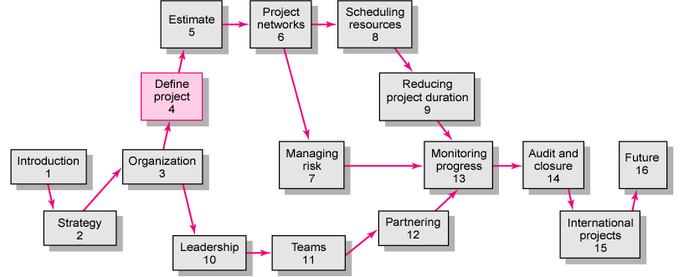
Copyright © 2006 The McGraw-Hill Companies. All rights reserved.
McGraw-Hill/Irwin 4–<number>
Notes:
PART 1:
Introduction: Concepts of PM
Strategy: How a Company’s Strategy can affect the project selection
Organization: Structure and Culture
Leadership: How to become an effective PM → Need to earns skills: teamwork, partnering

Slide 4
EVALUATION
Mid-term grade (50%)
Final grade (50%)
  Final Exam (60-65min) 40%
  Group Assignment 5%
  Quiz + Participation in class 5%
Copyright © 2006 The McGraw-Hill Companies. All rights reserved.
McGraw-Hill/Irwin 4–<number>

Slide 5
Group Assignment
Number of groups: 8
Each group will be given a case/ exercise
A report with solution(s) of the case is requested to submit in Dec 11, 2017
Each group will have 15min. to present their case and solution(s)
Copyright © 2006 The McGraw-Hill Companies. All rights reserved.
McGraw-Hill/Irwin 4–<number>

Slide 6
Group Assignment
Group | Assignment
1 | Whistler Ski Resort Project
2 | CyClon Project
3 | Greendale Stadium Case
4 | Nightingale Project – A
5 | Nightingale Project – B
6 | The “Now” Wedding – Part A
7 | Scanner Project
8 | Product Warranty Project
Copyright © 2006 The McGraw-Hill Companies. All rights reserved.
McGraw-Hill/Irwin 4–<number>

